Slide 1
Data visualizations

Slide 2
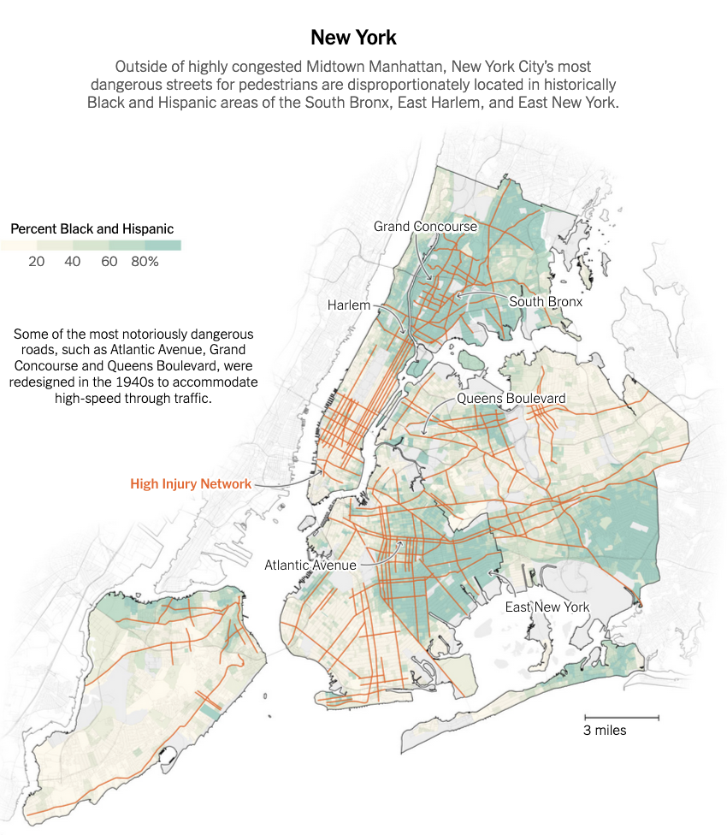
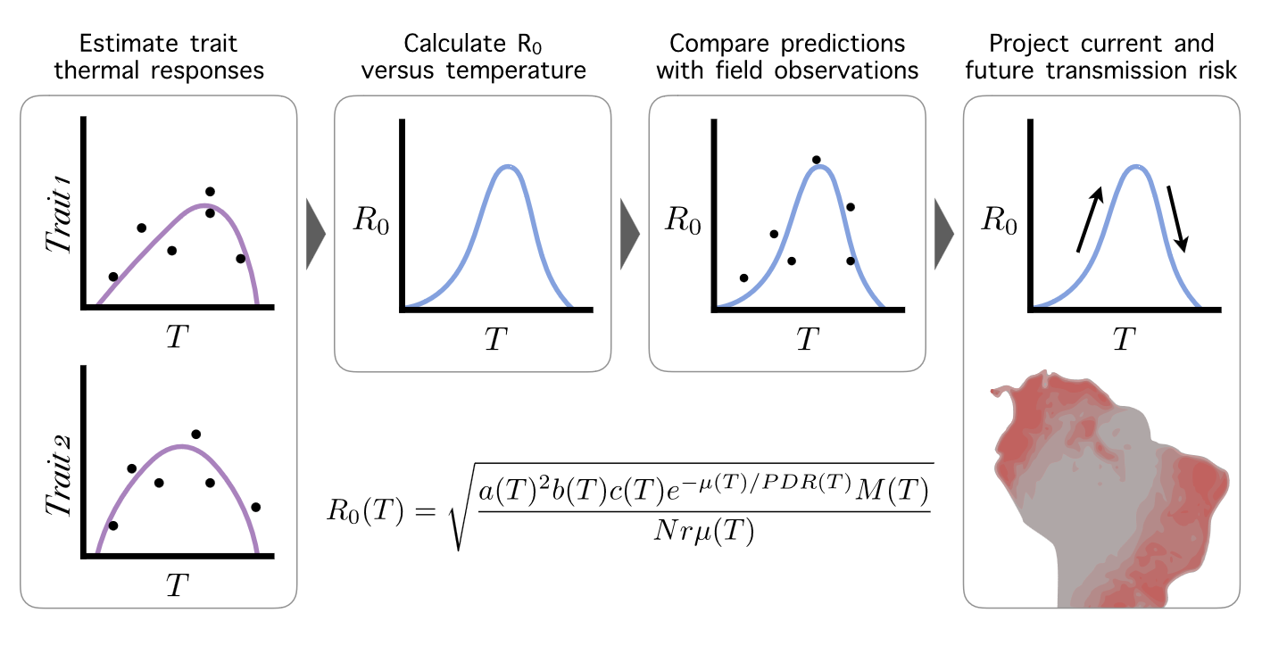
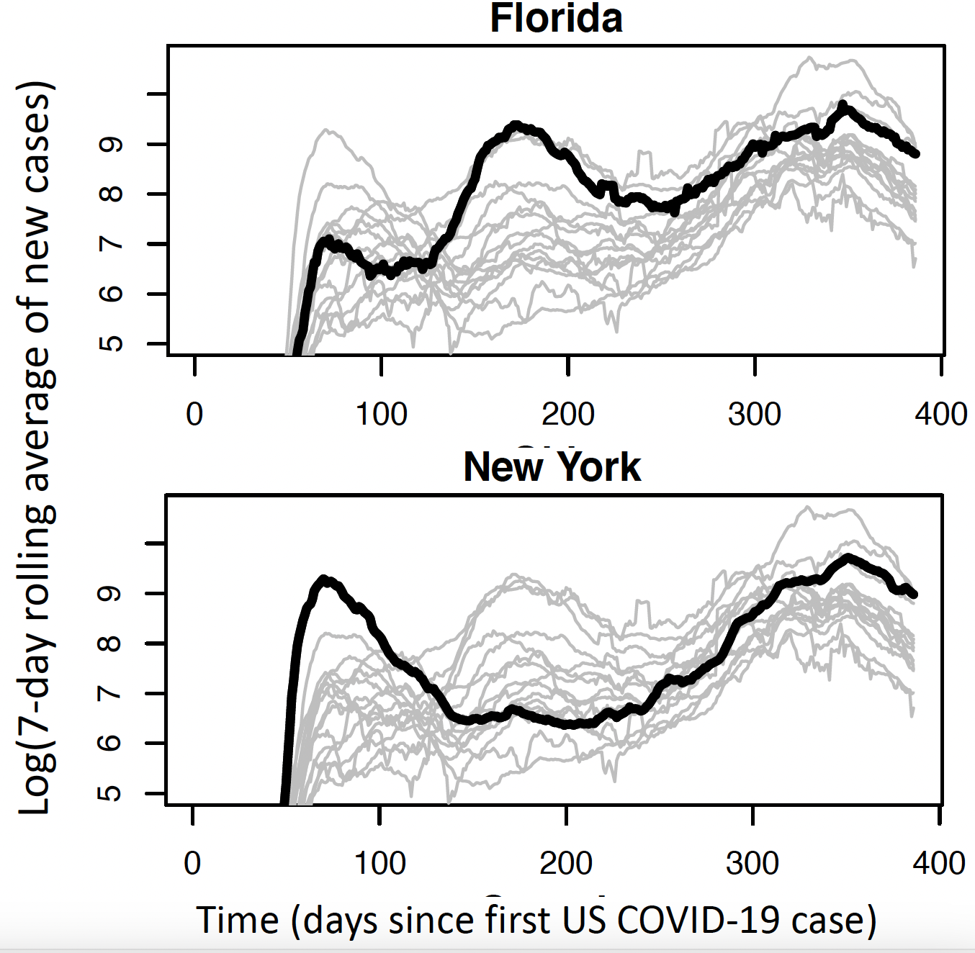
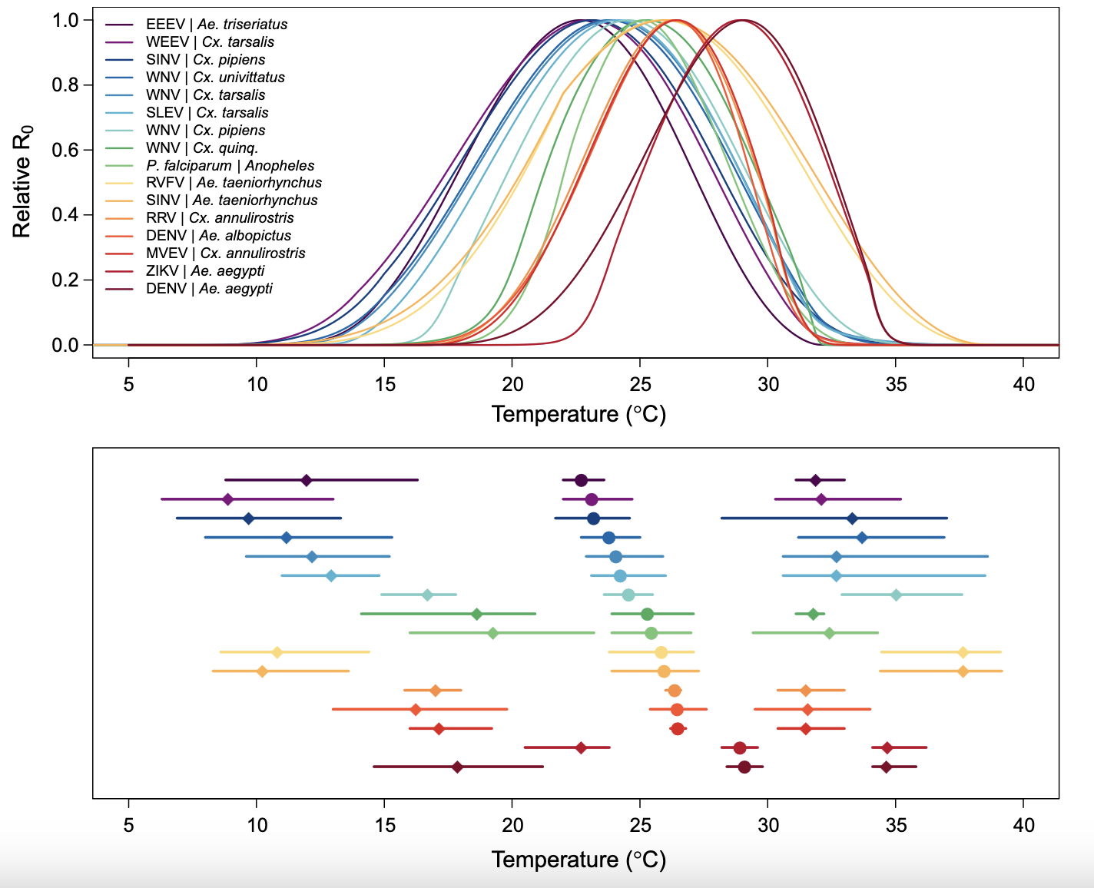
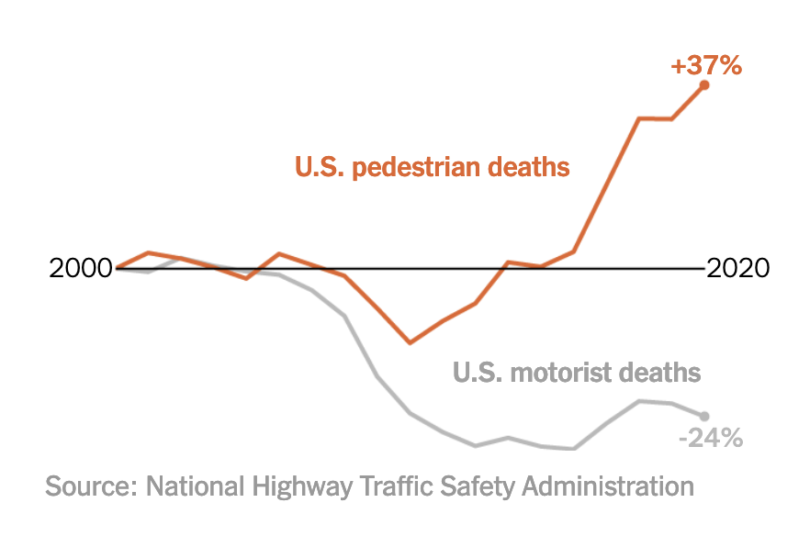
What is the purpose of making a figure?

Slide 3
What is the purpose of making a figure?
Visualizing abundant and complicated information is more efficient than describing it in words
Visualize ideas
Visualize data
Visualize methodology

Slide 4
All figures should have a purpose
Use figures to make the audience’s life easier
Use figures to
Show evidence
Illustrate difficult concepts
Illustrate complex experimental designs
Show synthesis

Slide 5
What are features of effective figures?

Slide 6
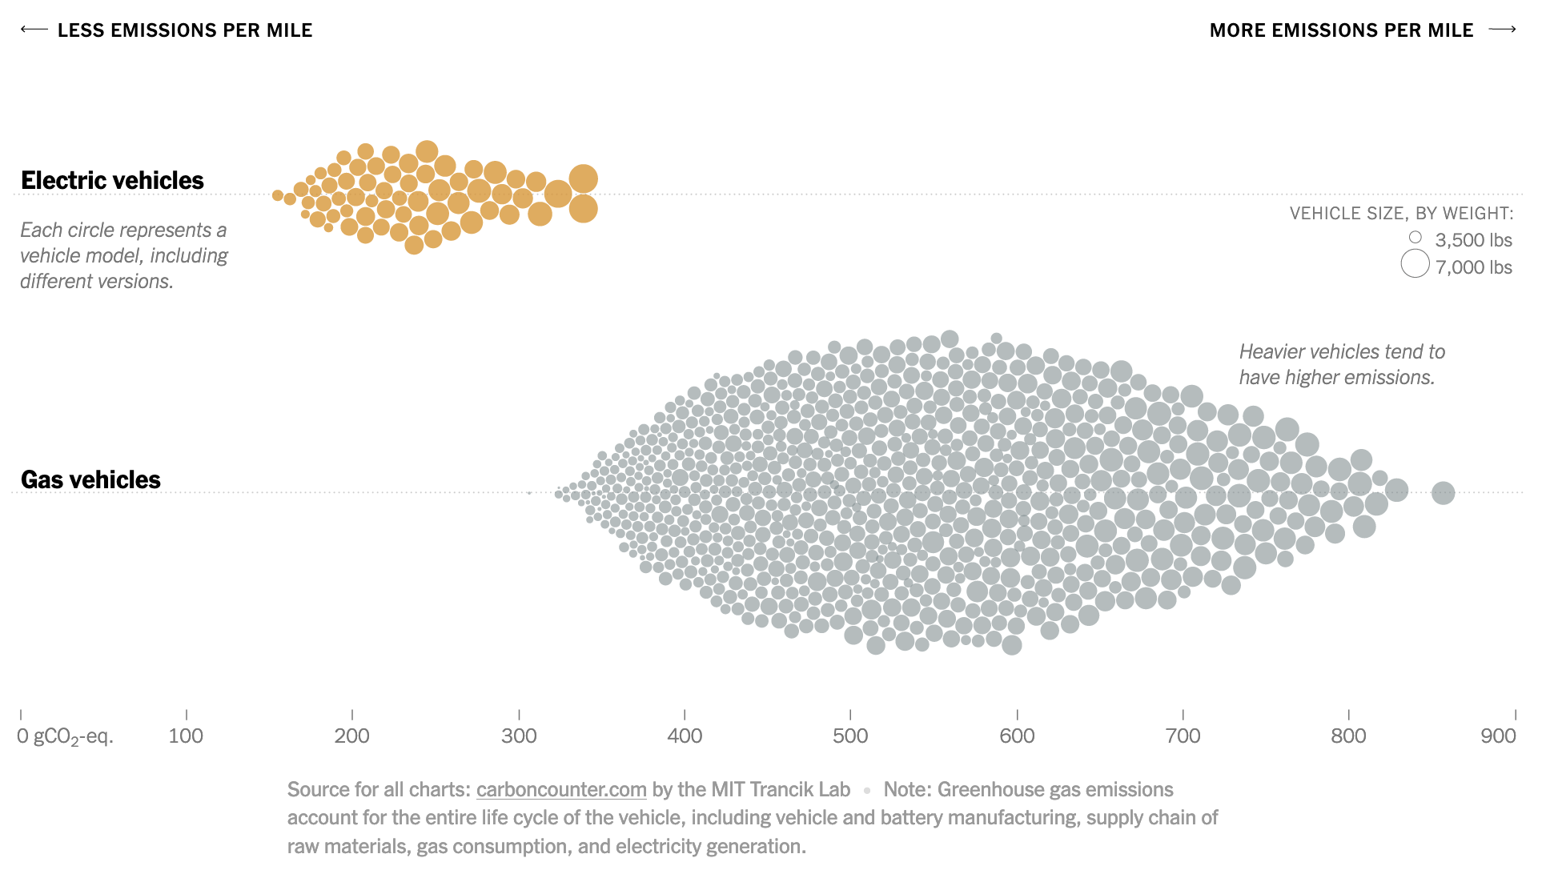
What are features of effective figures?
Purpose is clear
Design limits cognitive load
Design is universally accessible
Design is simple
Data:ink ratio is large

Slide 7
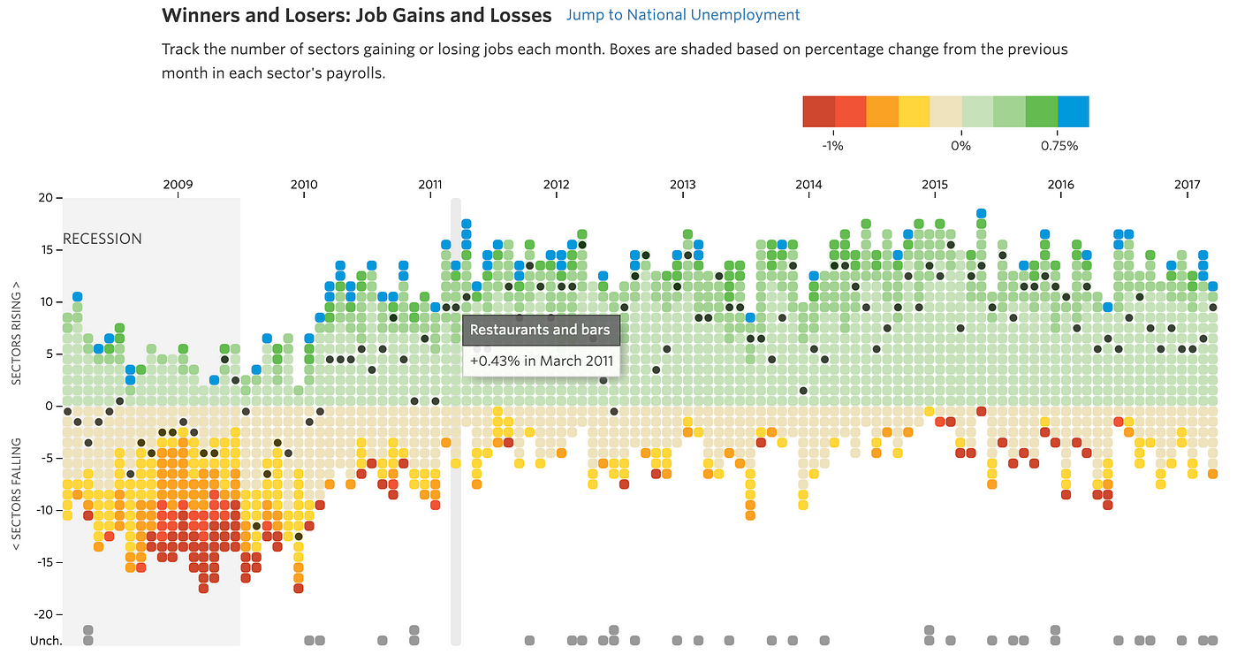
What are features of effective figures?
Purpose is clear
Design limits cognitive load
Design is universally accessible
Design is simple
Data:ink ratio is large

Slide 8
What are features of ineffective figures?

Slide 9
What are features of ineffective figures?
Figures erroneously modify information
Distracting elements
Design invites incorrect comparisons

Slide 10
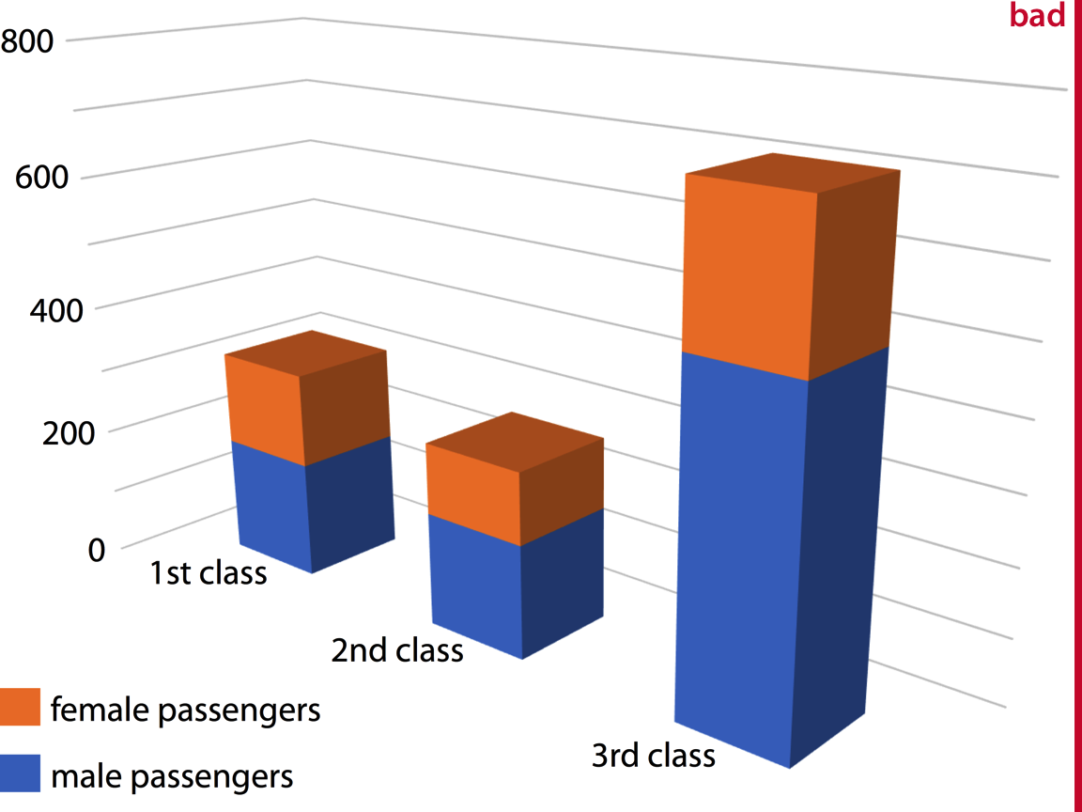
1. Erroneous modification of data: Visualization modifies perception of data
Orange and blue areas disproportionate to data they represent
1st and 2nd class ink outsized.
Female ink is outsized.

Slide 11

1. Erroneous modification of data: Data presented in non-intuitive way

Slide 12
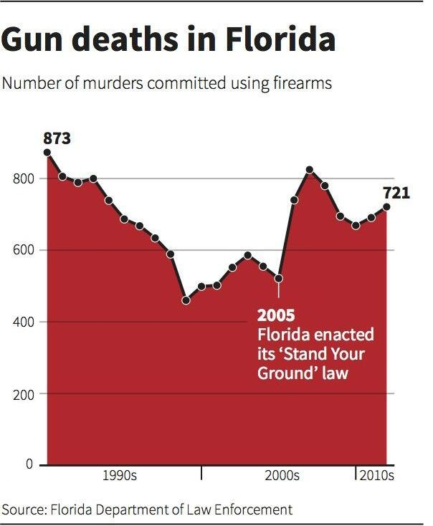
1. Erroneous modification of data: Data presented in non-intuitive way

Slide 13
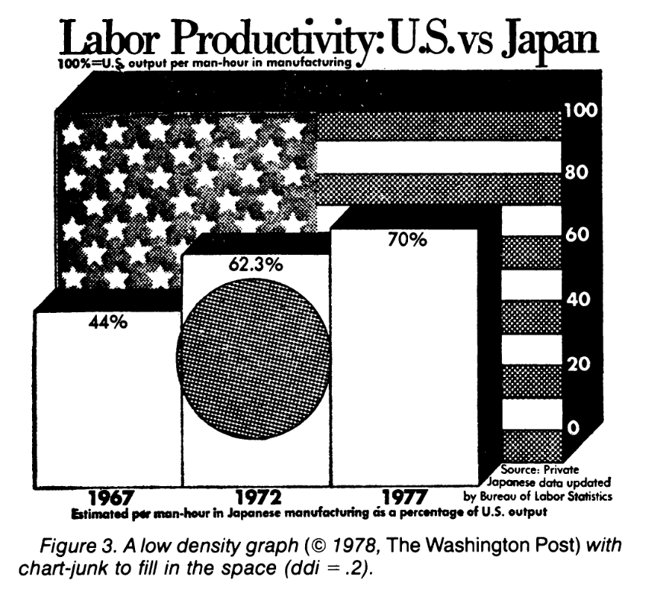
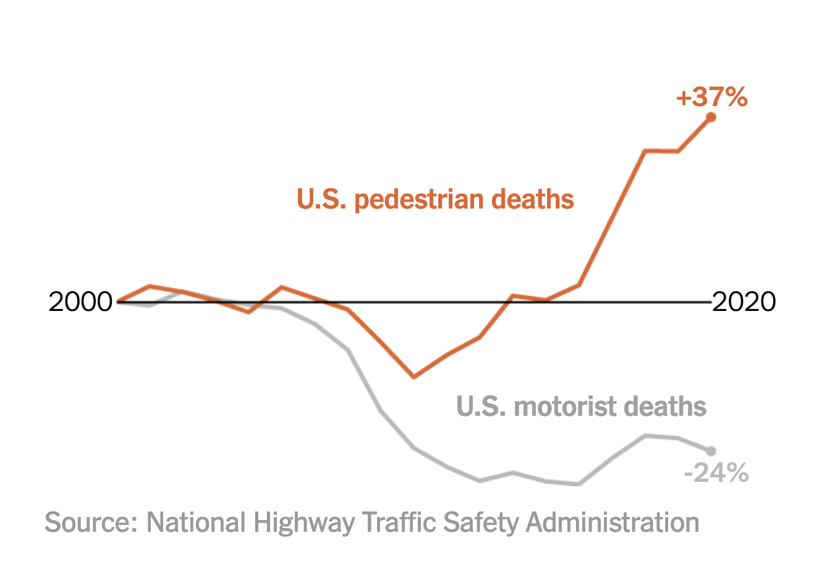
2. Distracting Elements
From NYTimes.

Slide 14
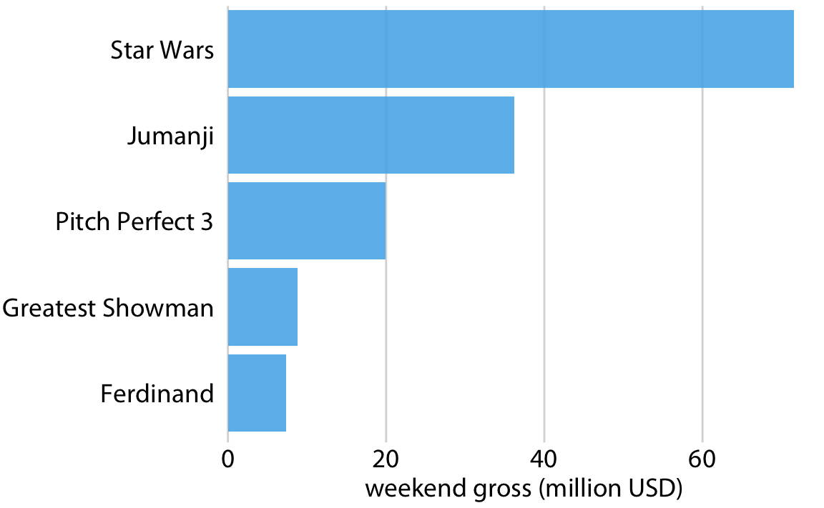
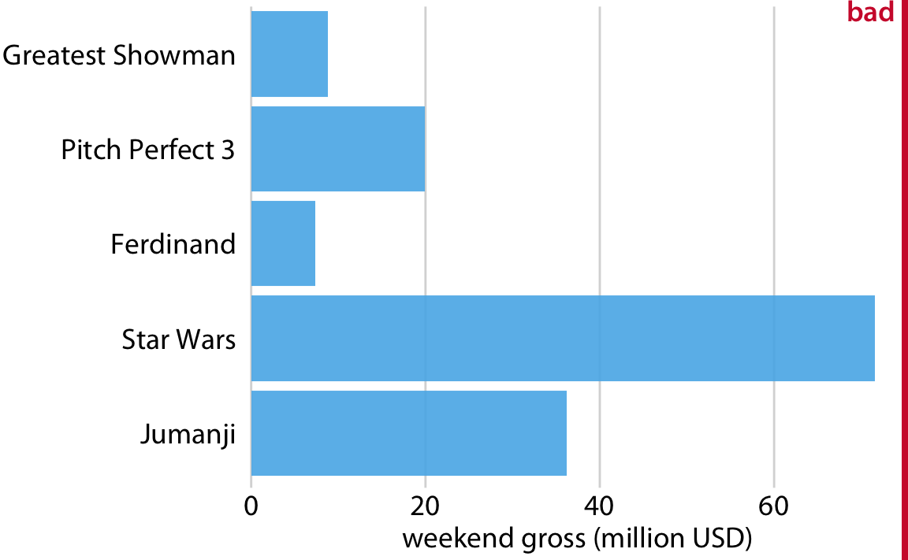
3. Design invites incorrect comparisons
Ordering here ranks movies by their profit.
Ordering here ranks movies by the length of their name.

Slide 15
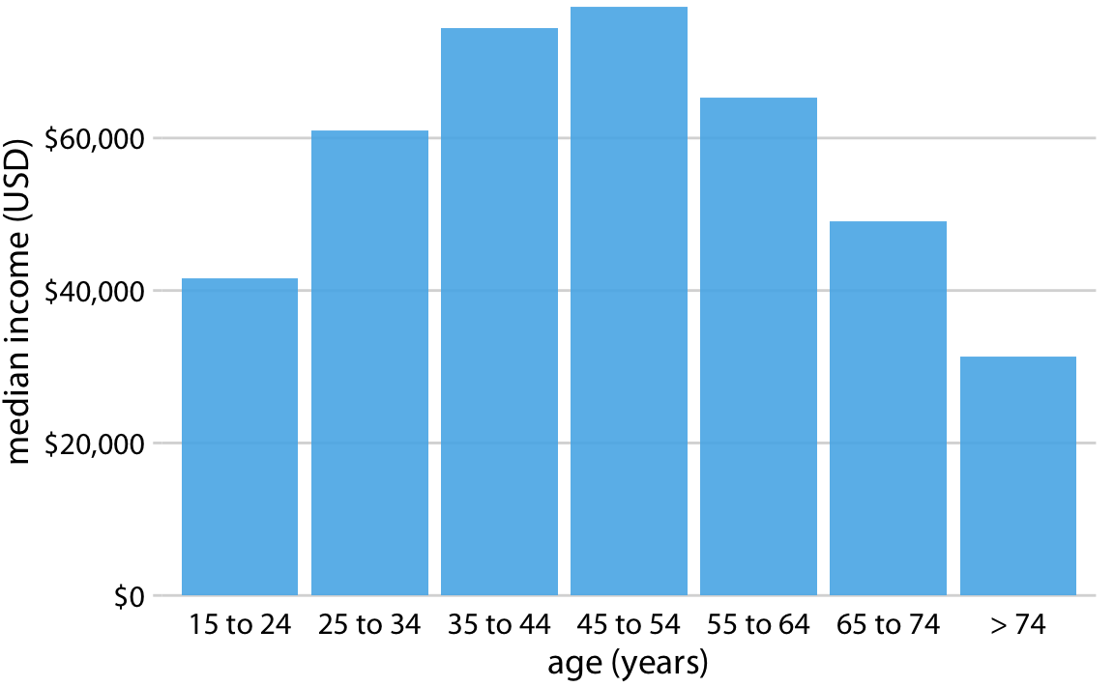
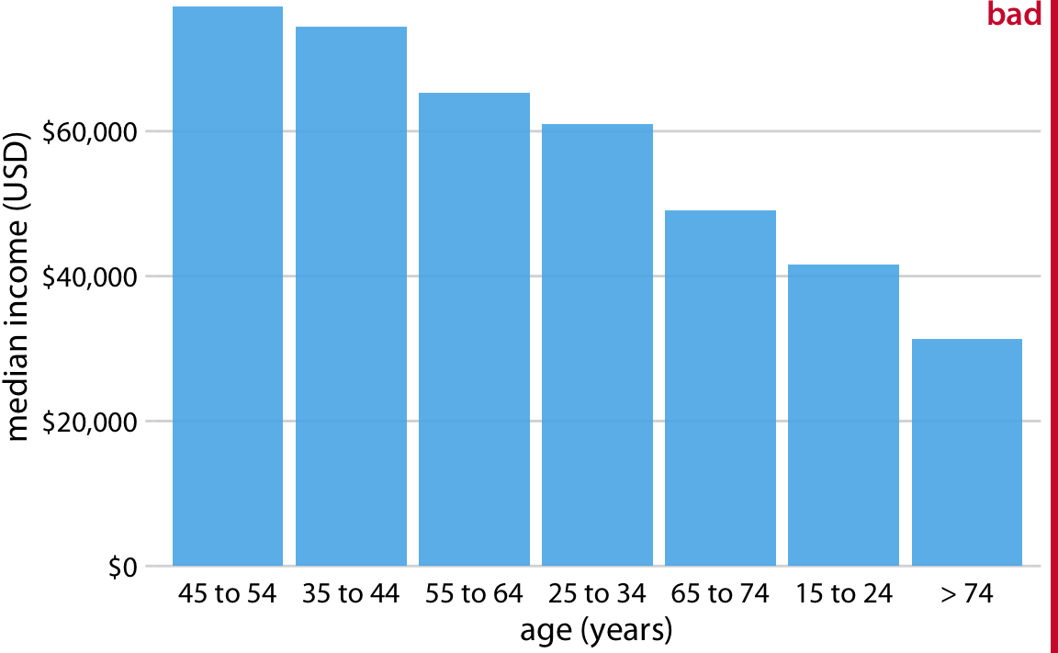
3. Design invites incorrect comparisons
Ordering by age.
Ordering by median income.

Slide 16
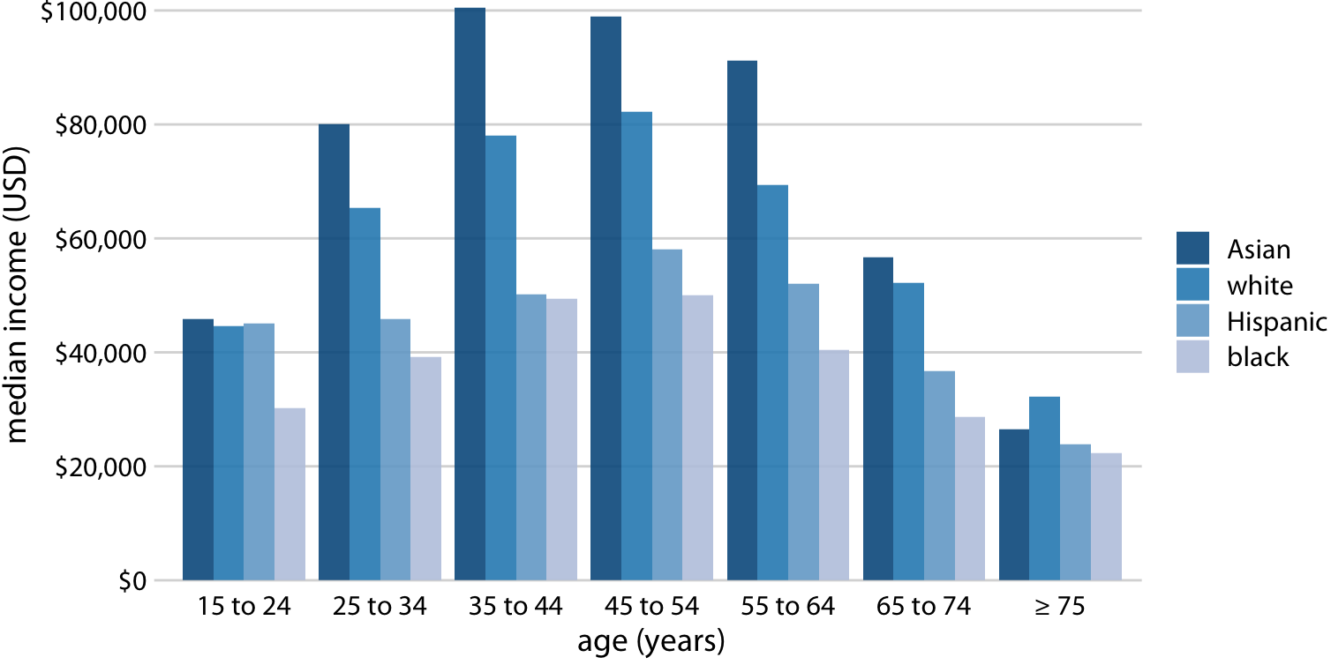
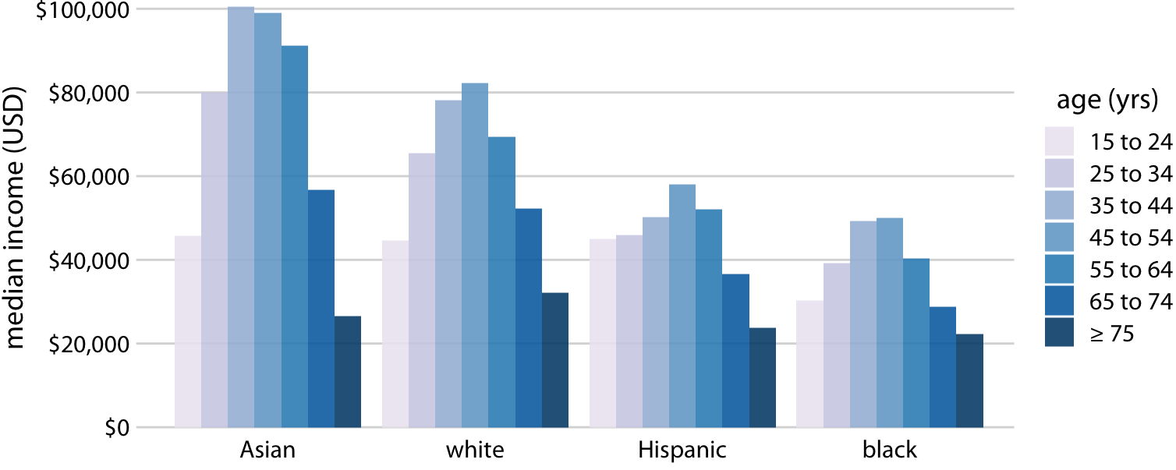
Ordering influences the message and interpretation
Ordering emphasizes differences in income by race
Ordering emphasizes differences in income by age
In this ordering, you are invited to compare distributions by race, making and age and race comparisons relatively simple.

Slide 17
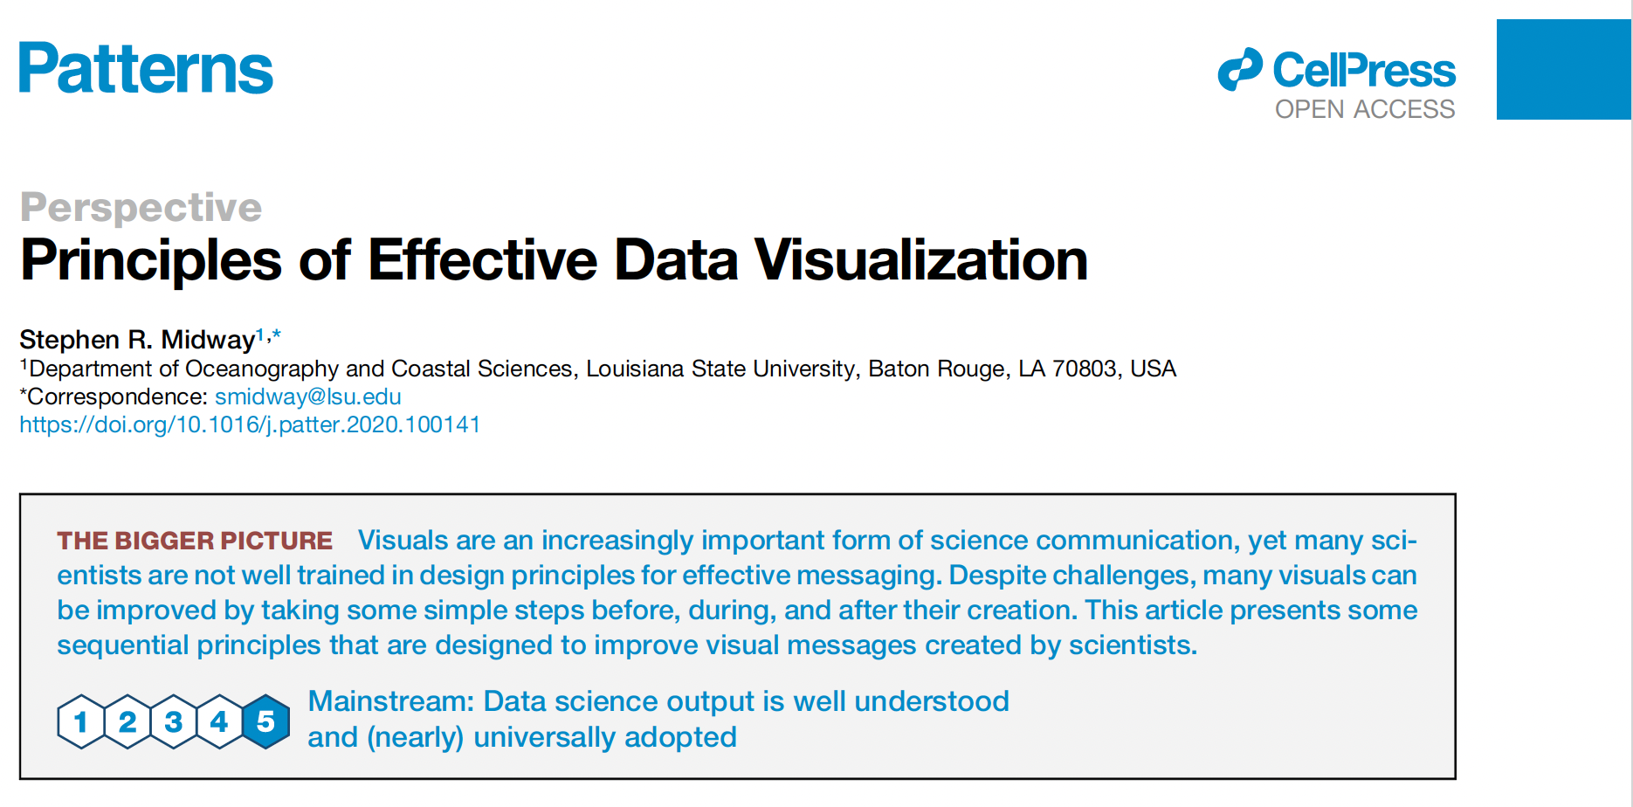
Guiding Principles (From Midway 2020)
1. Diagram First
2. Use the correct software
3. Use an effective geometry to show data
4. Ensure that colors always mean something
5. Include Uncertainty
6. Panel, when possible
7. Data and models are different things
8. Simple visuals, complex captions
9. Consider an infographic
10. Get an opinion

Slide 18
1. Diagram First
Making figures is often difficult and requires technical skill
Let your ideas and story determine the look and design of figures
Diagrams can be edited quickly and finalized
Software can make it look professional

Slide 19
2. Use correct software
Don’t limit yourself to what you already know
Software has limitations. Don’t let the limitations of software constrain your ability to make good figures
E.g. Everyone has excel, but the capabilities of excel are very limited (and the defaults are unsightly)
We’ll learn R for making figures. As you develop, maybe you decide other software is better.

Slide 20
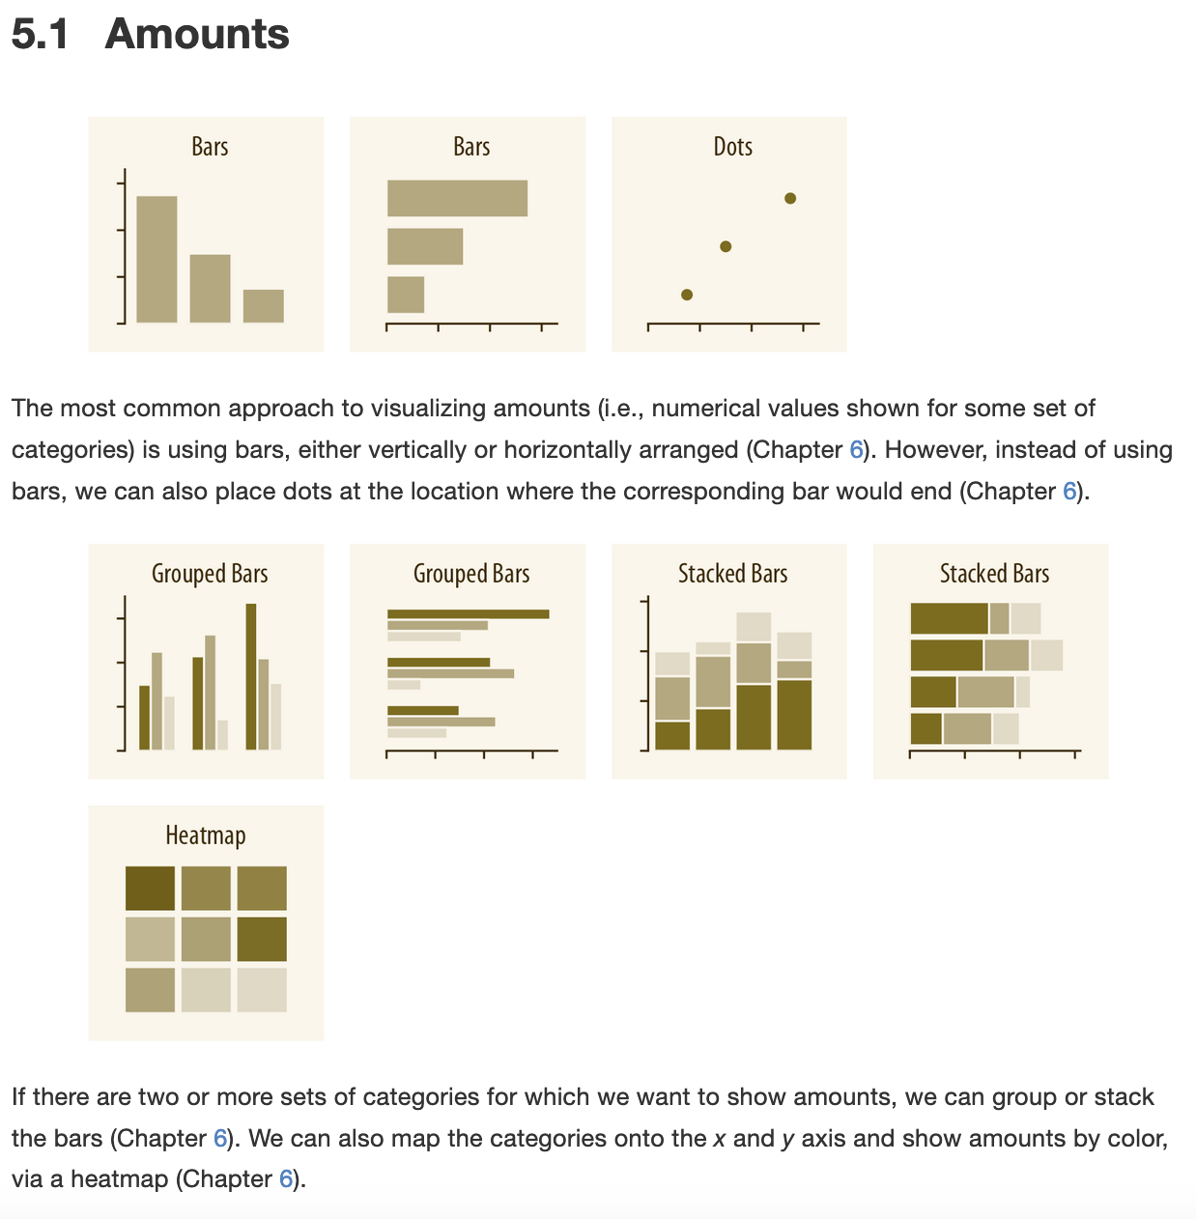
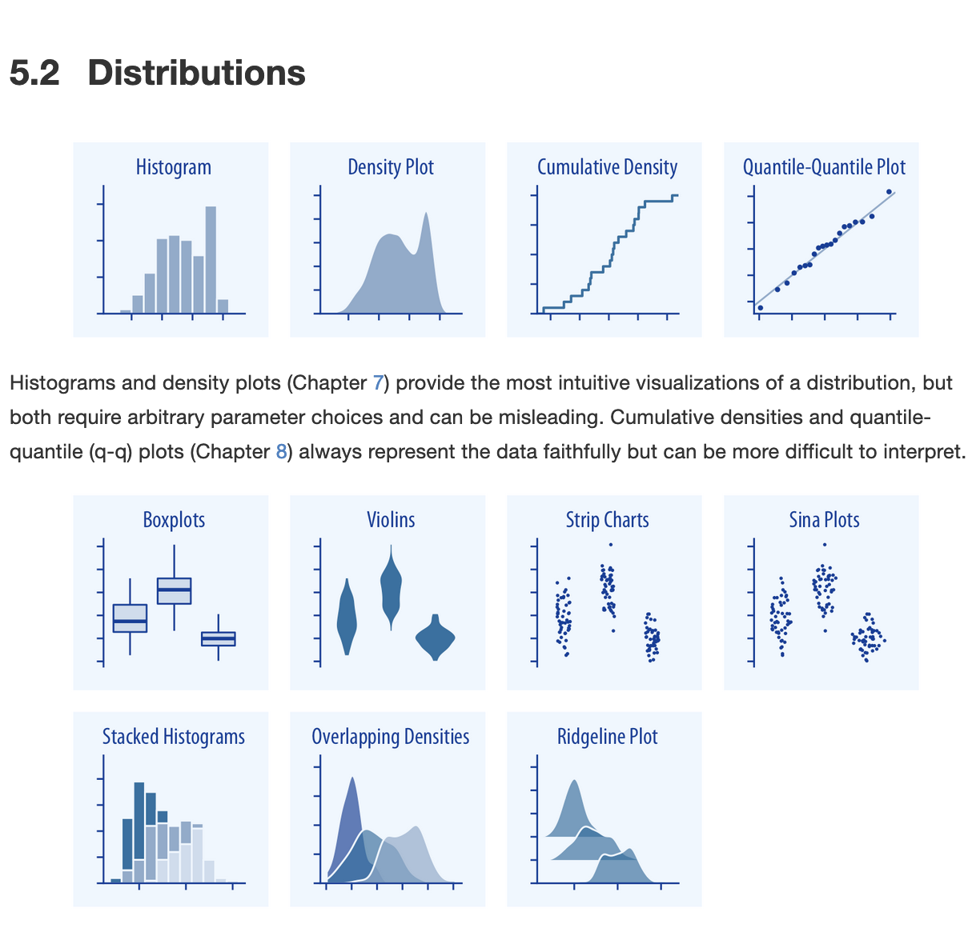
3. Use an effective geometry to show data
Amounts
Distributions

Slide 21
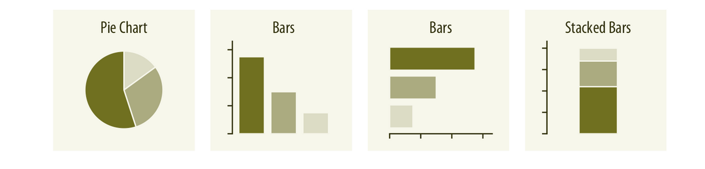
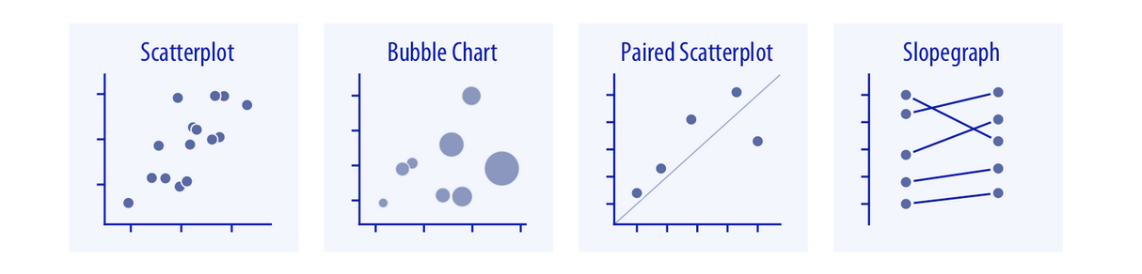
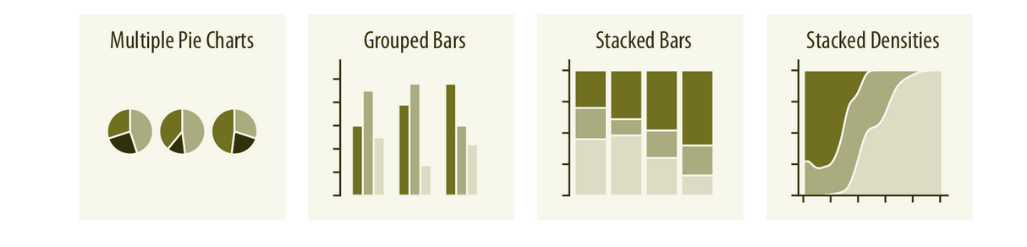
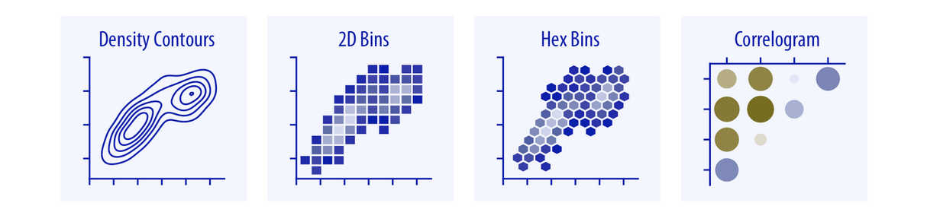
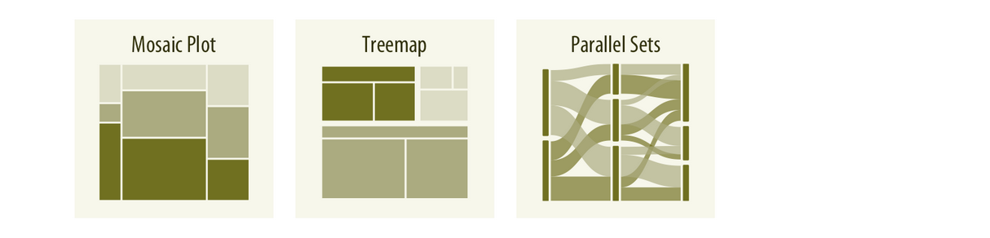
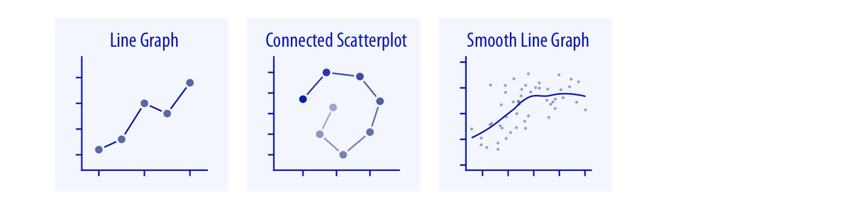
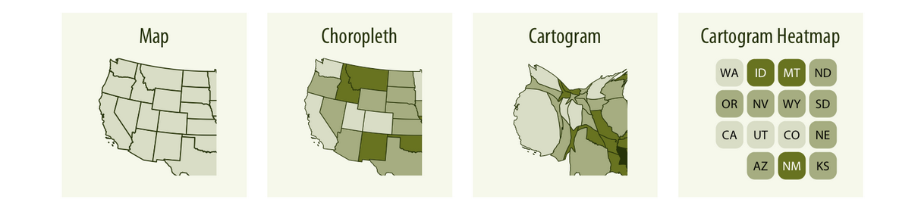
3. Use an effective geometry to show data
Proportions
Relationships between 2 variables
Geospatial Data

Slide 22
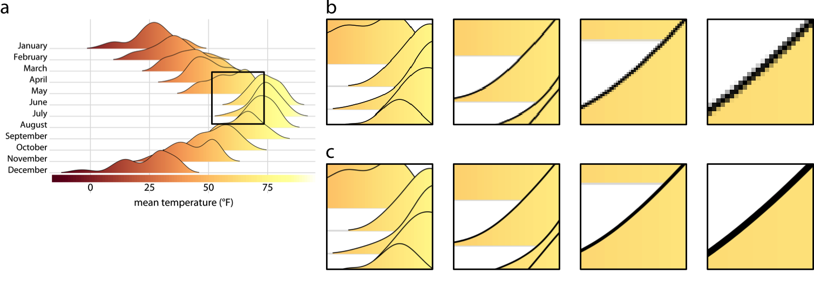
4. Ensure that colors mean something
Color variation in highly visible
Your audience will purposely (or unconsciously) focus on them
Use color only when they embed meaning
Unnecessary colors pose problems
Messy
Non-intuitive
Noisy
Possible color-blind issues

Slide 23
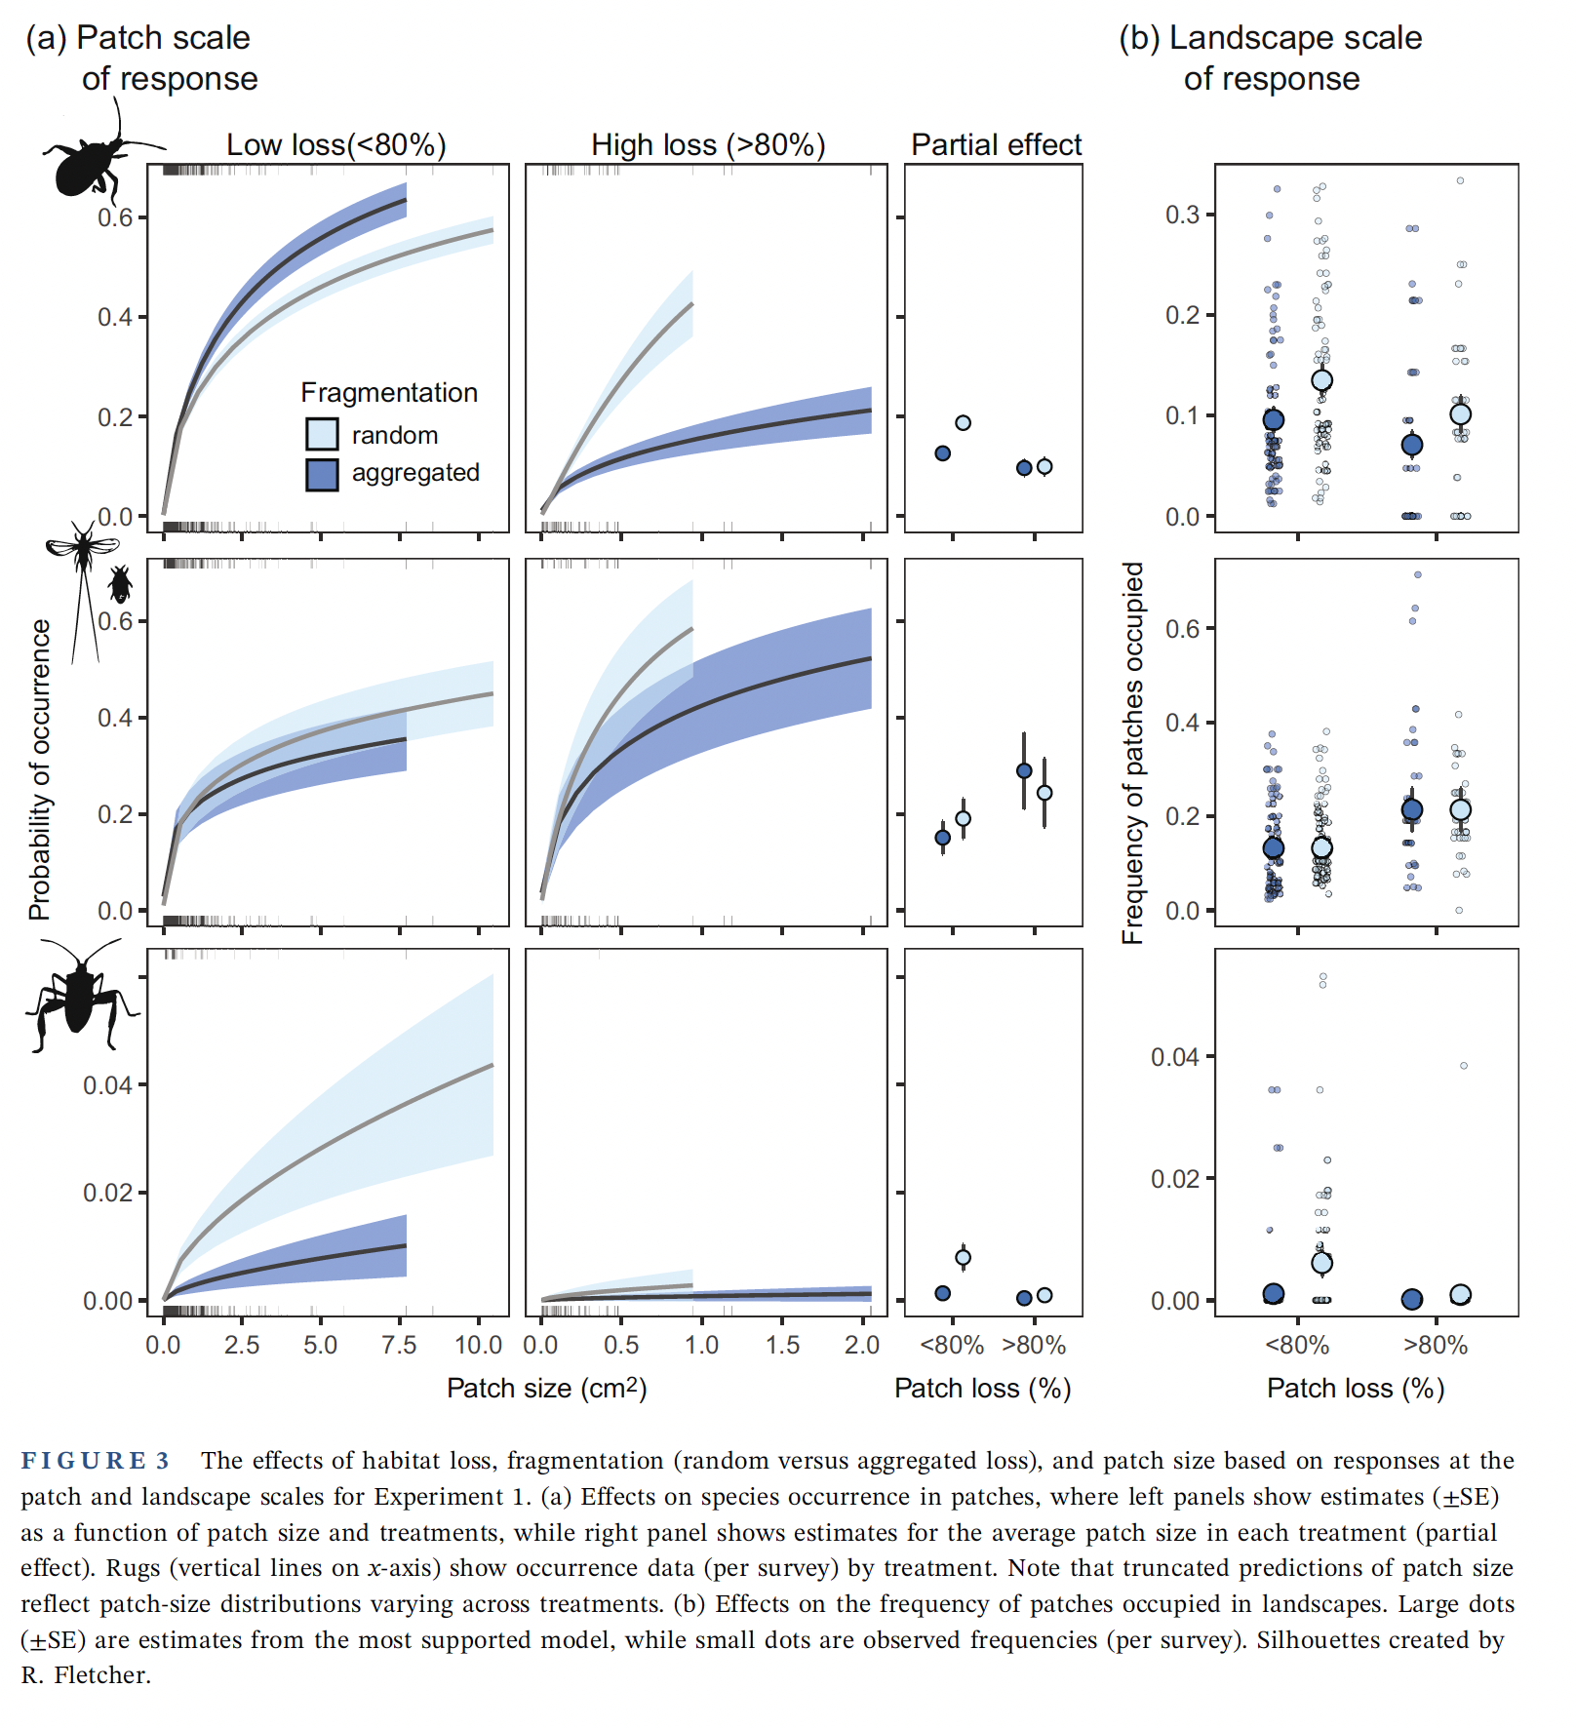
5. Include uncertainty
Data are one thing
But there is uncertainty in data in our interpretation of the data
Show and explain the uncertainty
E.g., Error bars and confidence intervals
Showing what you don’t know is just as important as what you do know!

Slide 24
6. Panel when possible
Paneling allows readers to break ideas and pieces of evidence into digestible pieces
But, they also allow the reader to view and compare how each piece relates to others
Caution: You can go overboard on paneling, especially in talks and presentations.

Slide 25
7. Data and models are different things
Data is the evidence we have
Models are how we understand and make sense of the evidence.
You need to show and clearly distinguish both

Slide 26
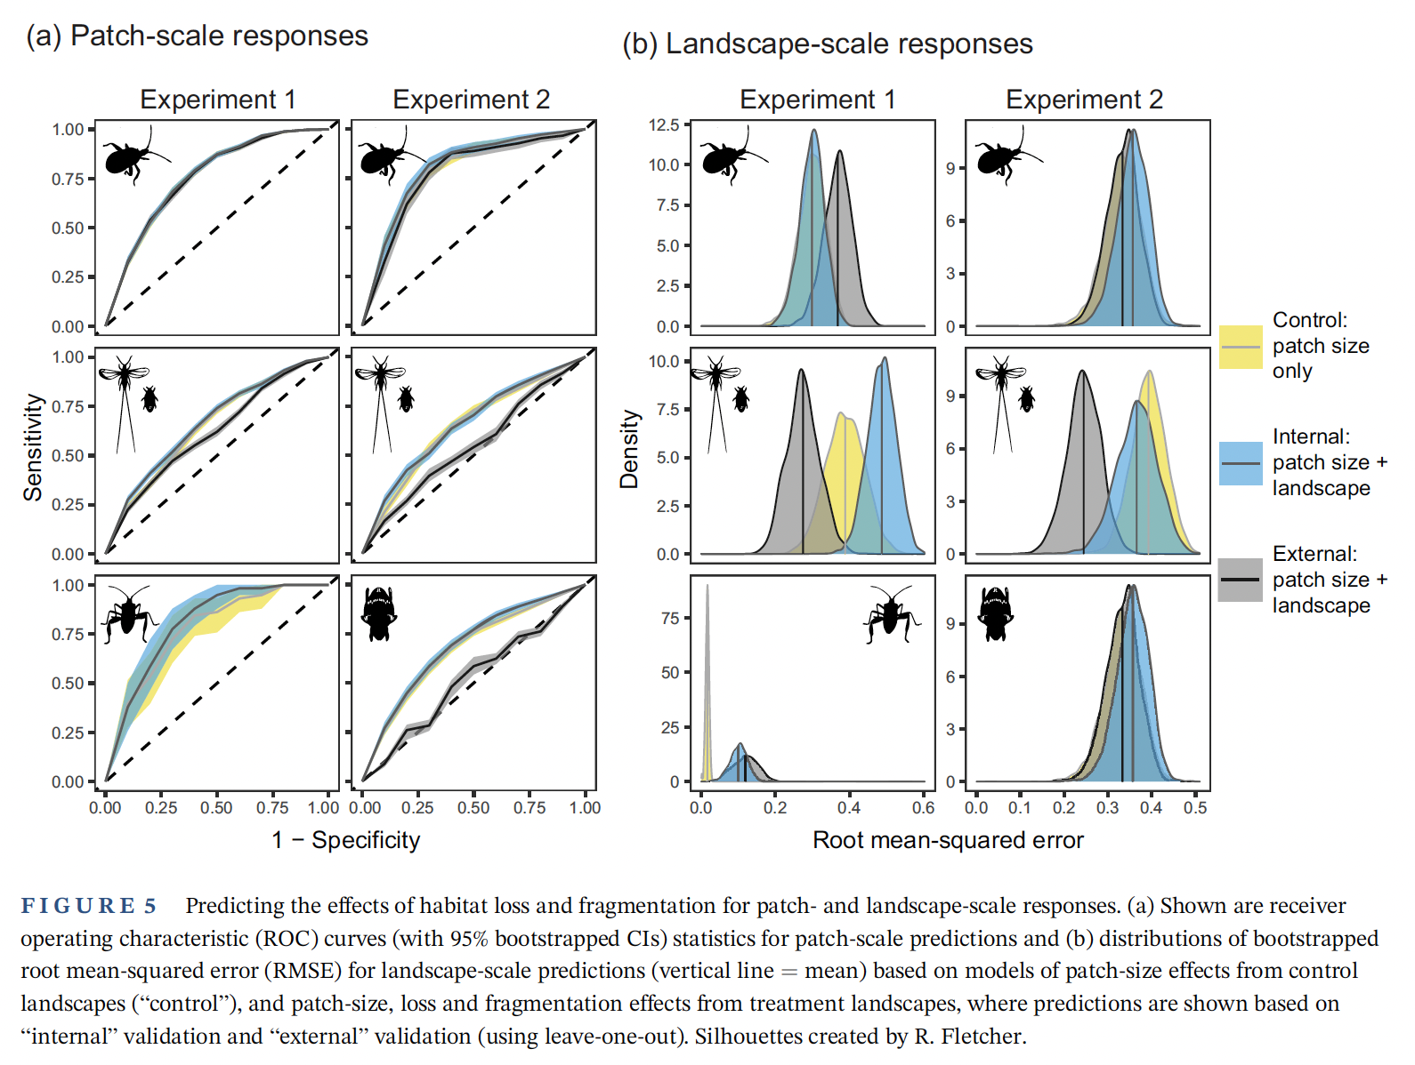
8. Simple visuals, complex captions
Know your audience
Use words that are meaningful to them
Explain the complex notation in the caption
Make the reader’s job easier!

Slide 27
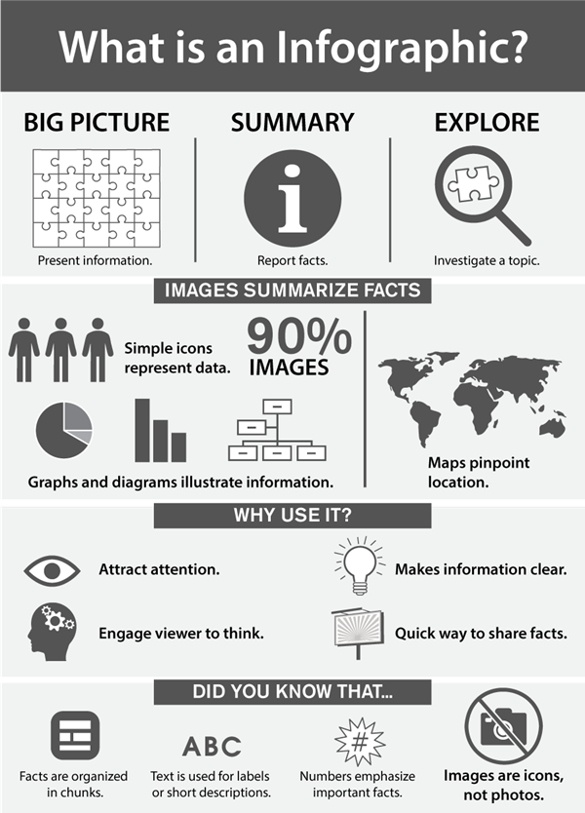

9. Consider an infographic
Plowright et al. 2024. Nature Communications

Slide 28
10. Get an opinion
You have multiple people in your orbit who see figures every day
Ask for their feedback
Take their feedback seriously
Ask
“What do you think the purpose of this figure is?”
”What is the main message of this figure?”
“I wanted to tell you X, can you see that in this figure?”

Slide 29
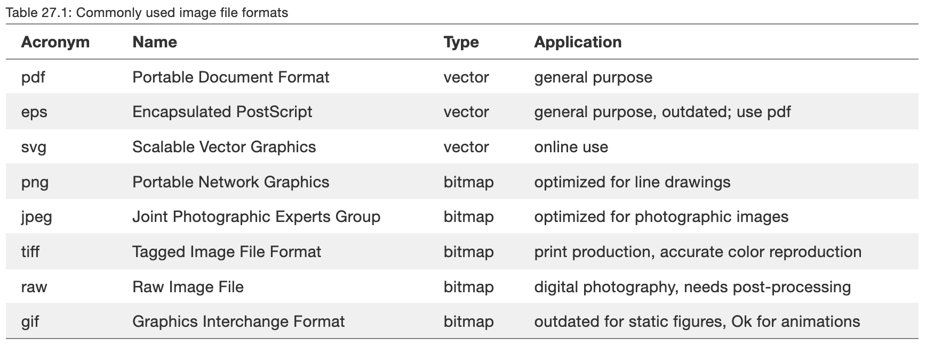
Image file formats

Slide 30
Use vector-based graphic when possible

Slide 31
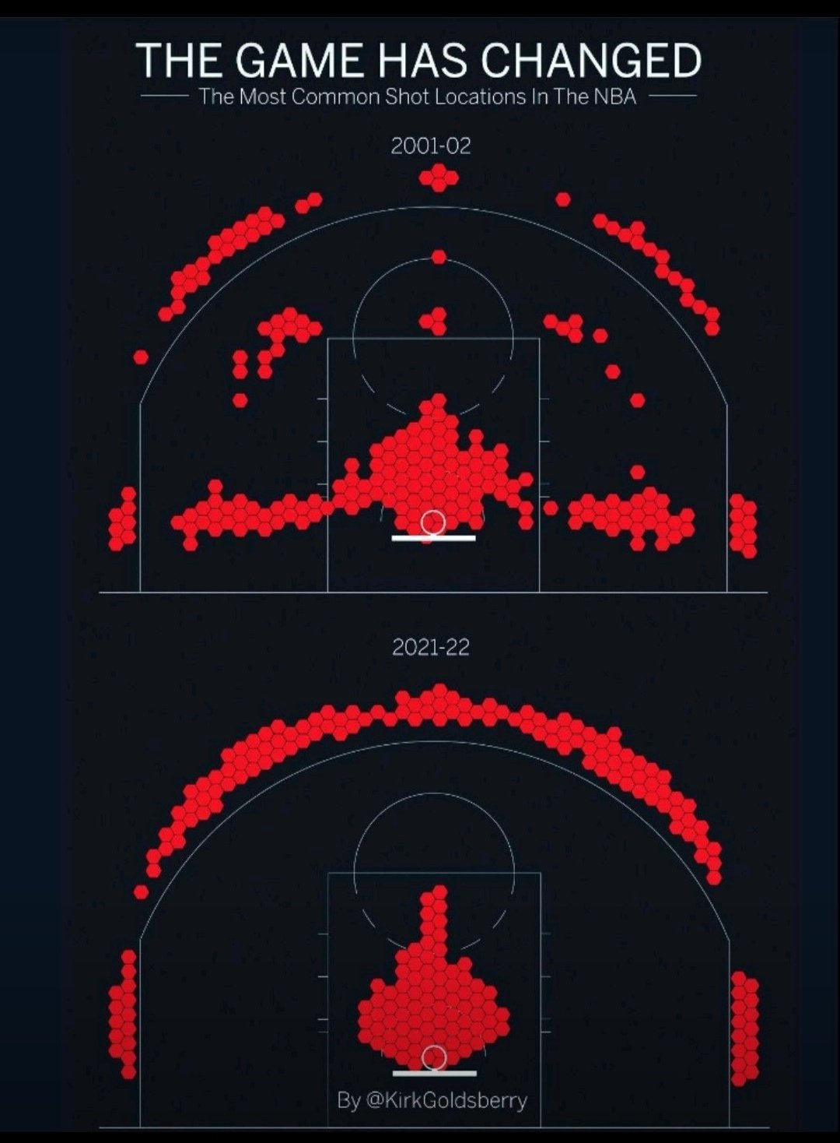
Other thoughts
Think about purpose of visual display
Storyboard and think about visual storytelling
Be creative
Find inspiration outside science
Pay attention to norms and expectations in your field. (Don’t create dissonance with audience unless necessary.)
Explore and find your workflow

